Slide 1
CASE STUDY ON CHATBOT
MENTOR
SUNIL JACOB
TEAM MEMBERS
RANGOLI RANJAN
SHOURYA AGARWAL
SNEHITHA REDDY

Slide 2
PROBLEM STATEMENT
User is a clinical person seeking help about Philips Patient Monitoring equipment on the Philips site. The job is to make it easier to choose using a Chatbot.

Slide 3
Programming Language: JAVA IDE: IntelliJ IDEA Libraries: Maven, Junit, JSON

Slide 4
TIMELINE
MILESTONE1 (22/7- 23/7)
MILESTONE2 (24/7- 29/7)
MILESTONE3 (29/7- 31/7)

Slide 5
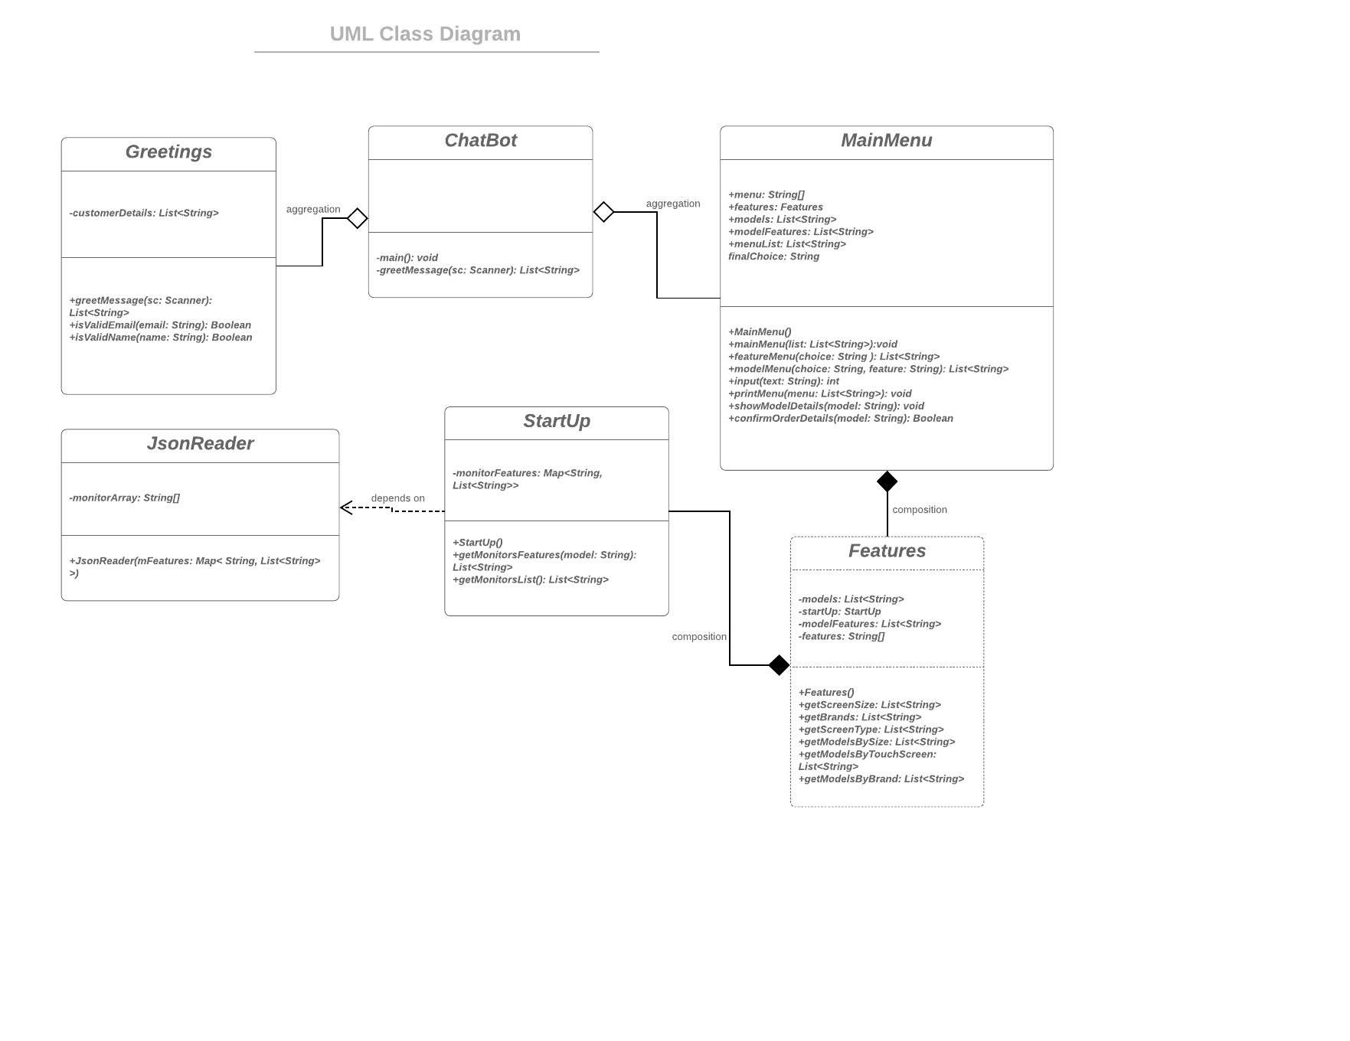
UML CLASS DIAGRAM

Slide 6
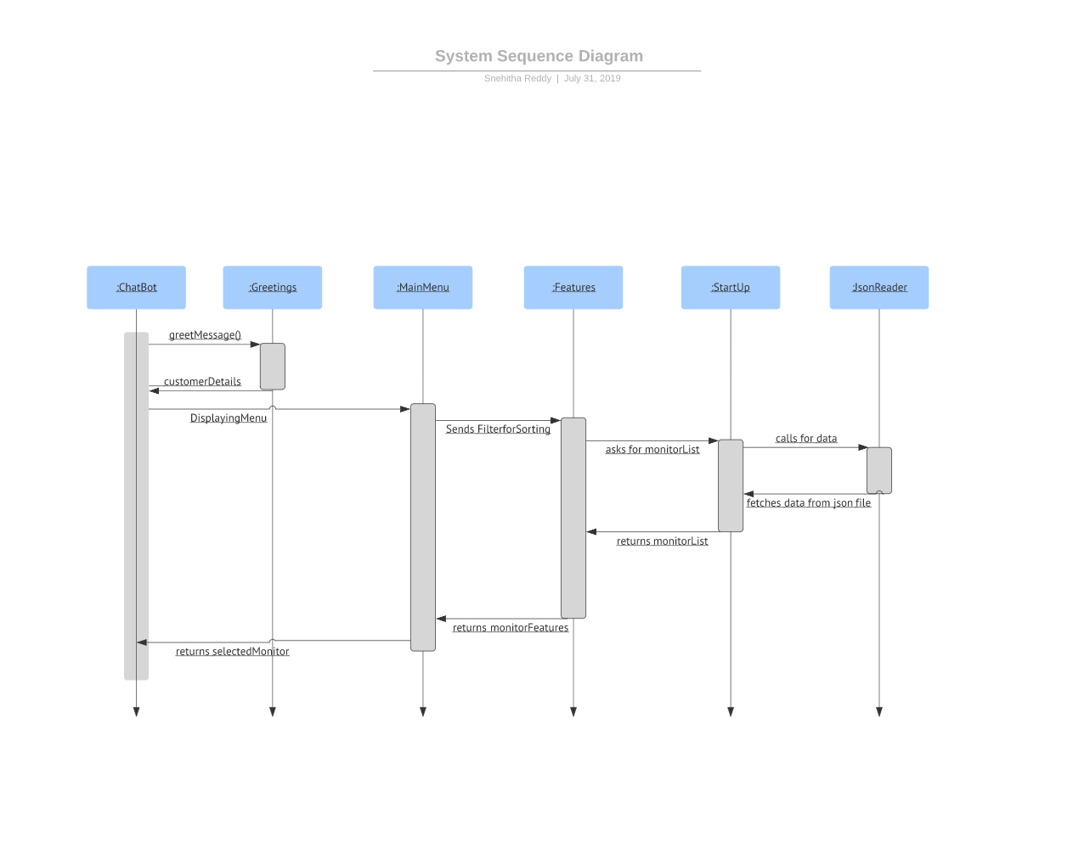
UML SEQUENCE DIAGRAM

Slide 7
THE END

